Slide 1
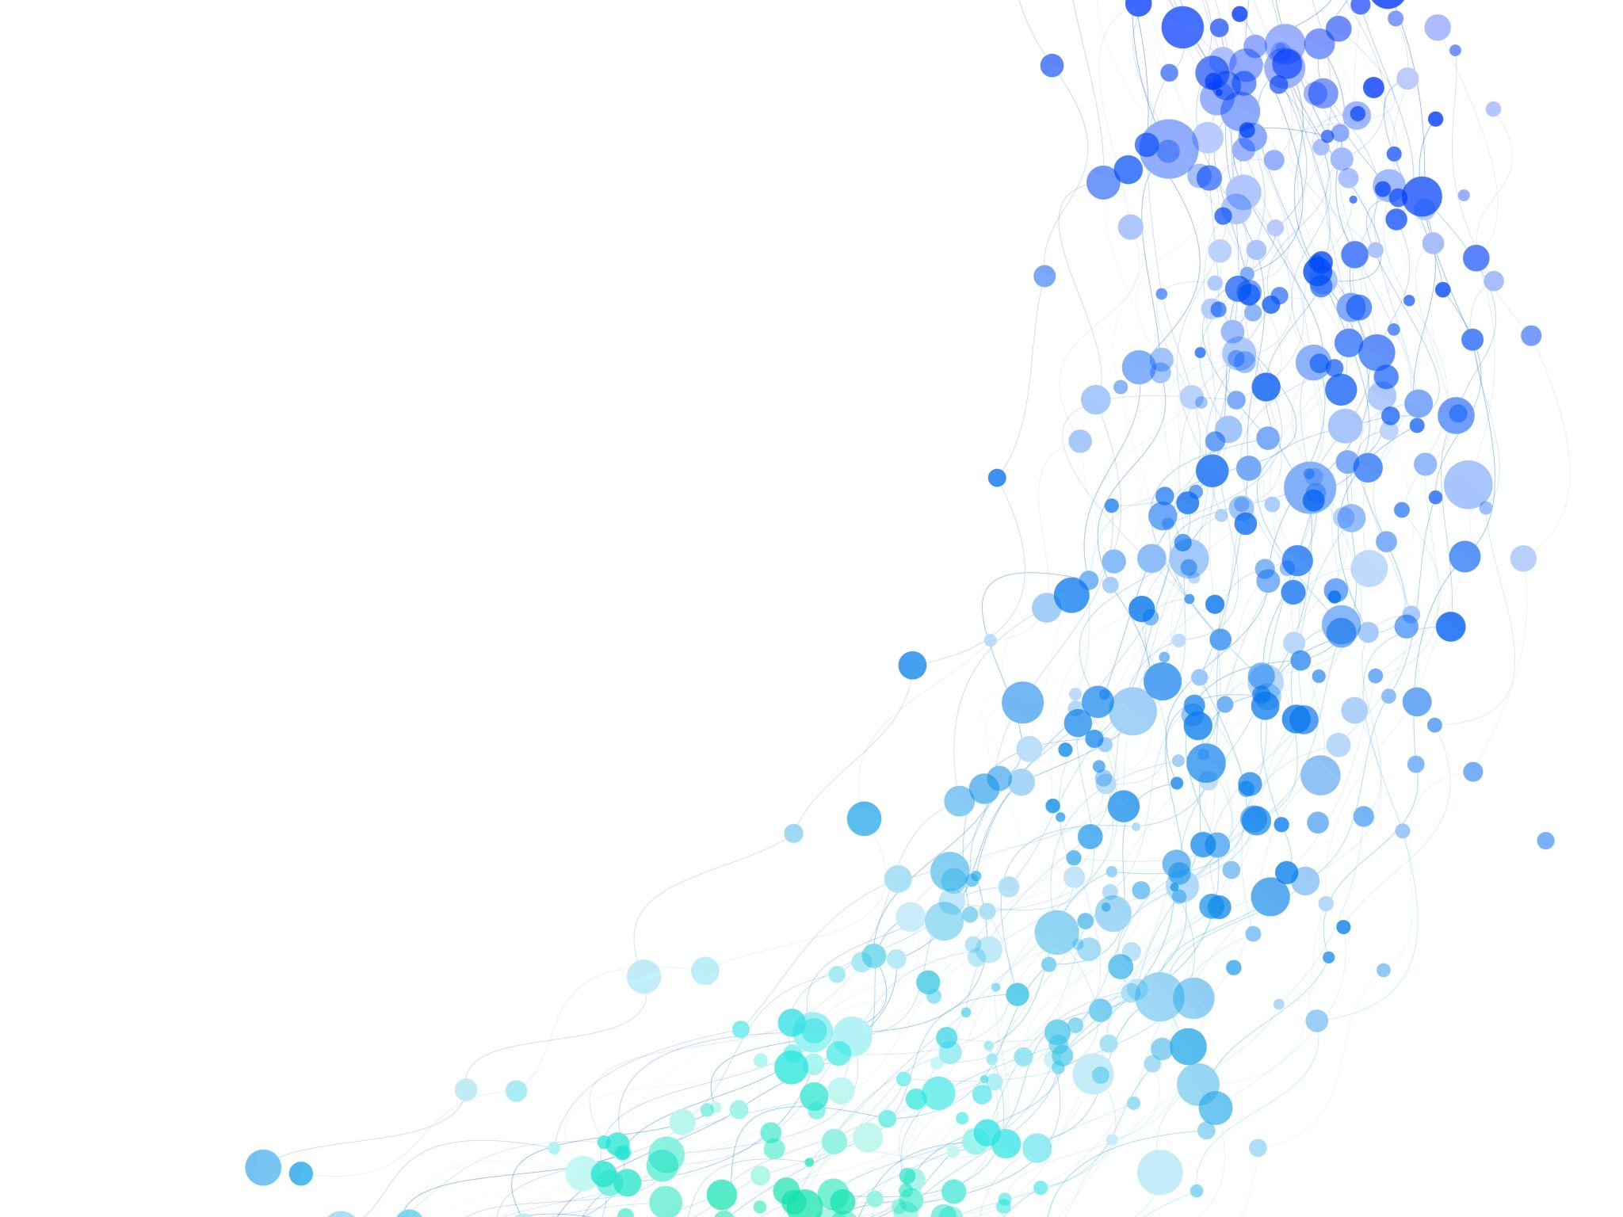
Shor’s Algorithm
Sparsh Gupta – DSA Final Project

Slide 2
What is Shor’s Algorithm?
Algorithm to factor integers.
Quantum-based.
Breaks the factoring problem into parts:
Period finding
Modular Exponentiation
Quantum Fourier Transform
Factor derivation

Slide 3
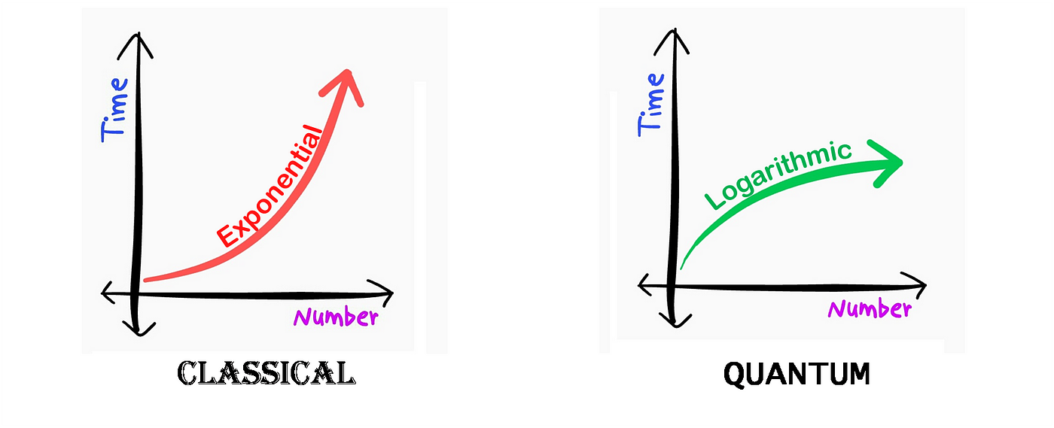
Why Shor’s Algorithm?
https://kaustubhrakhade.medium.com/shors-factoring-algorithm-94a0796a13b1

Slide 4
Background

Slide 5
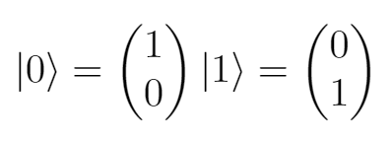
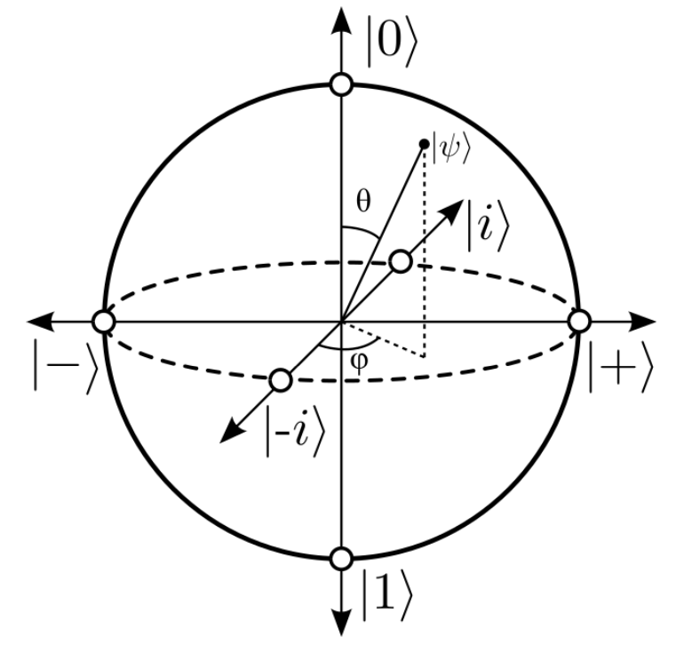
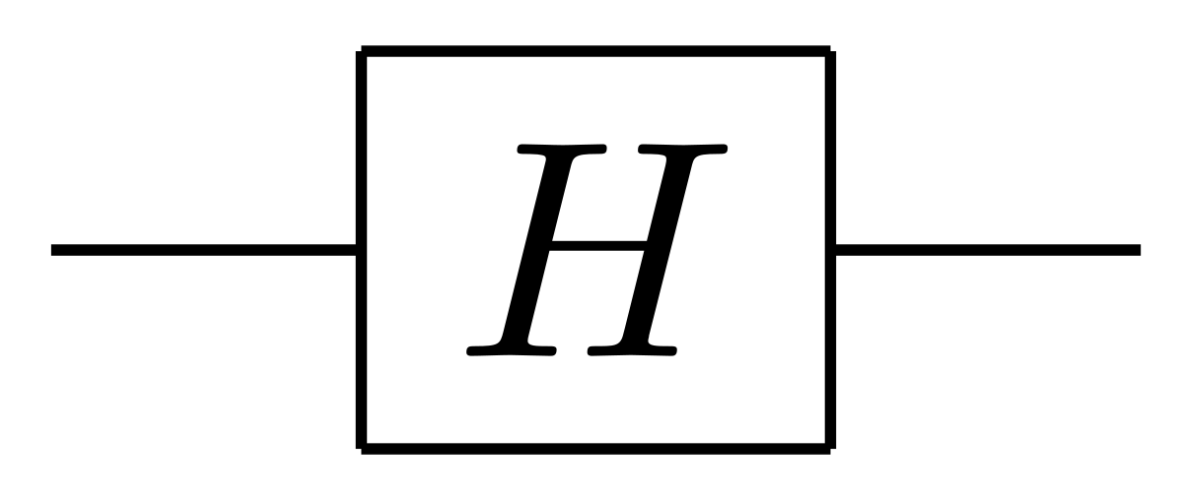
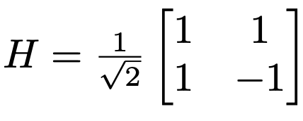
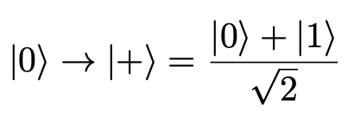
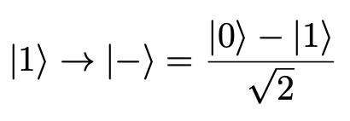
Qubit, Hadamard (H) Gate, Bloch Sphere

Slide 6
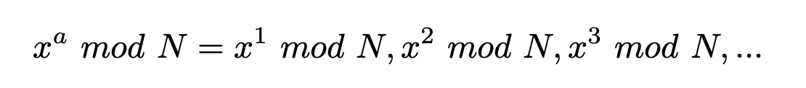
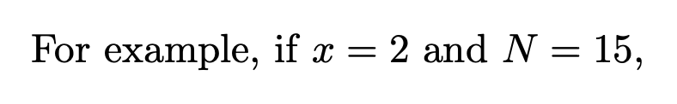
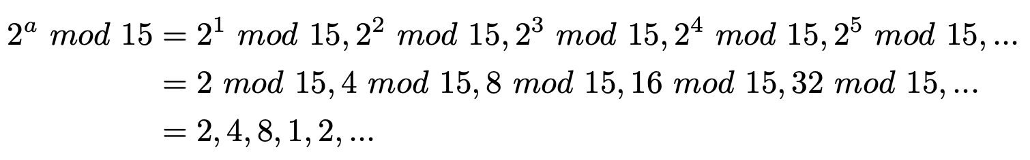
Modular Exponentiation

Slide 7
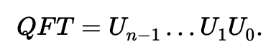
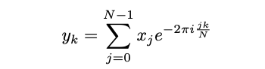
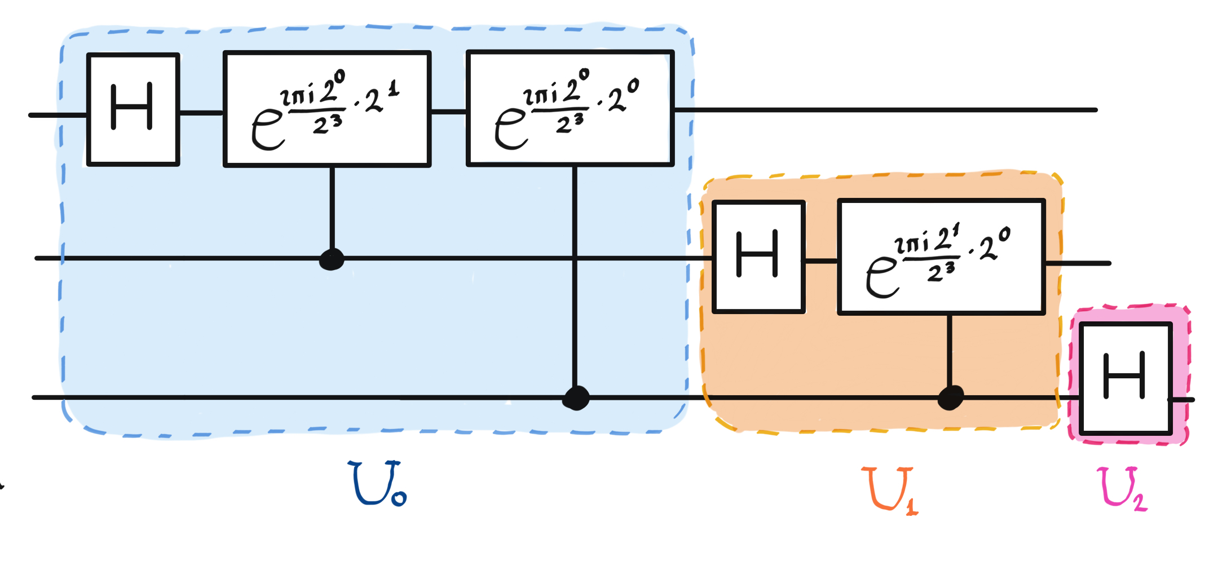
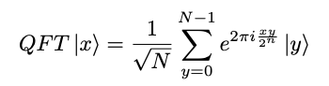
Quantum Fourier Transform (QFT)
Discrete Fourier Transform (DFT)
QFT
https://pennylane.ai/qml/demos/tutorial_qft/

Slide 8
Algorithm (with example)

Slide 9
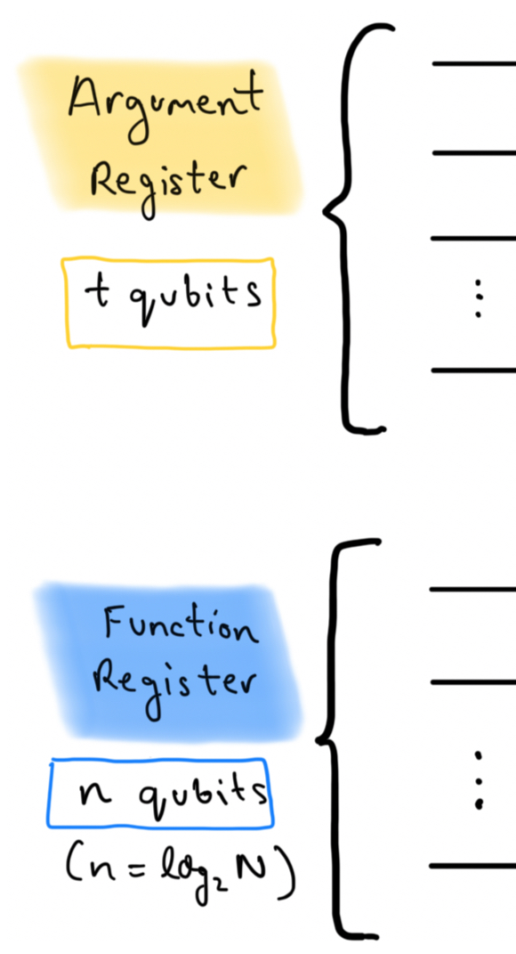
Initialization
N is the integer we want to factor. (it can’t be even)
x is a coprime integer.
We initialize two quantum circuit registers:
Argument register: t qubits
Function register: n qubits (n = log₂N)
Choose T = 2^t such that N^2 <= T <= 2N^2
For this example,
N = 21, x = 2, t = 9, n = 5, T = 512.

Slide 10
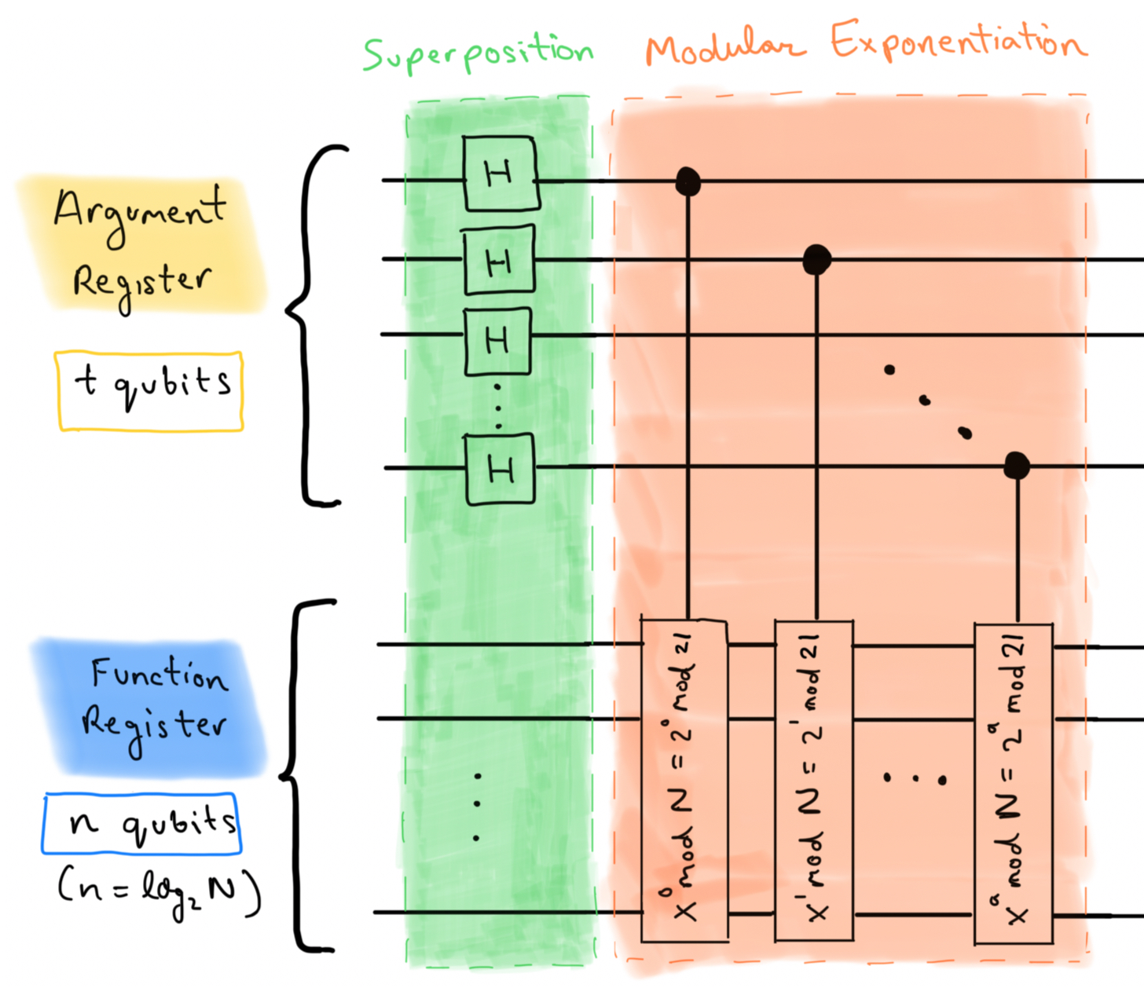
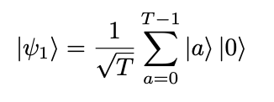
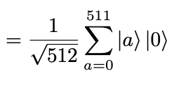
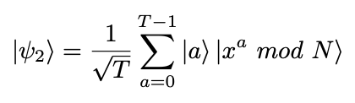
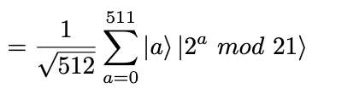
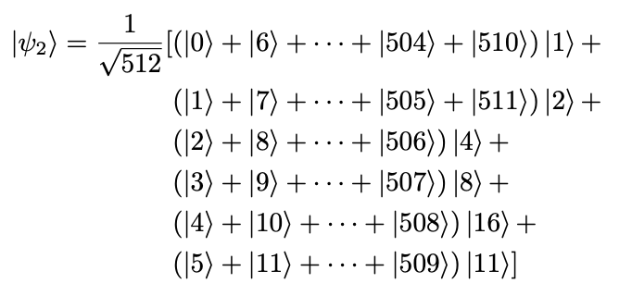
Superposition and Modular Exponentiation
(Superposition)
(Modular Exponentiation)
Notes:
This causes the quantum state to be highly entangled, and it demonstrates quantum parallelism with the modular exponentiation function.

Slide 11
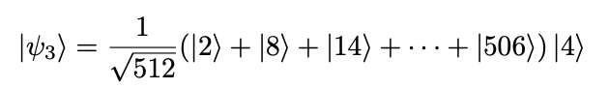
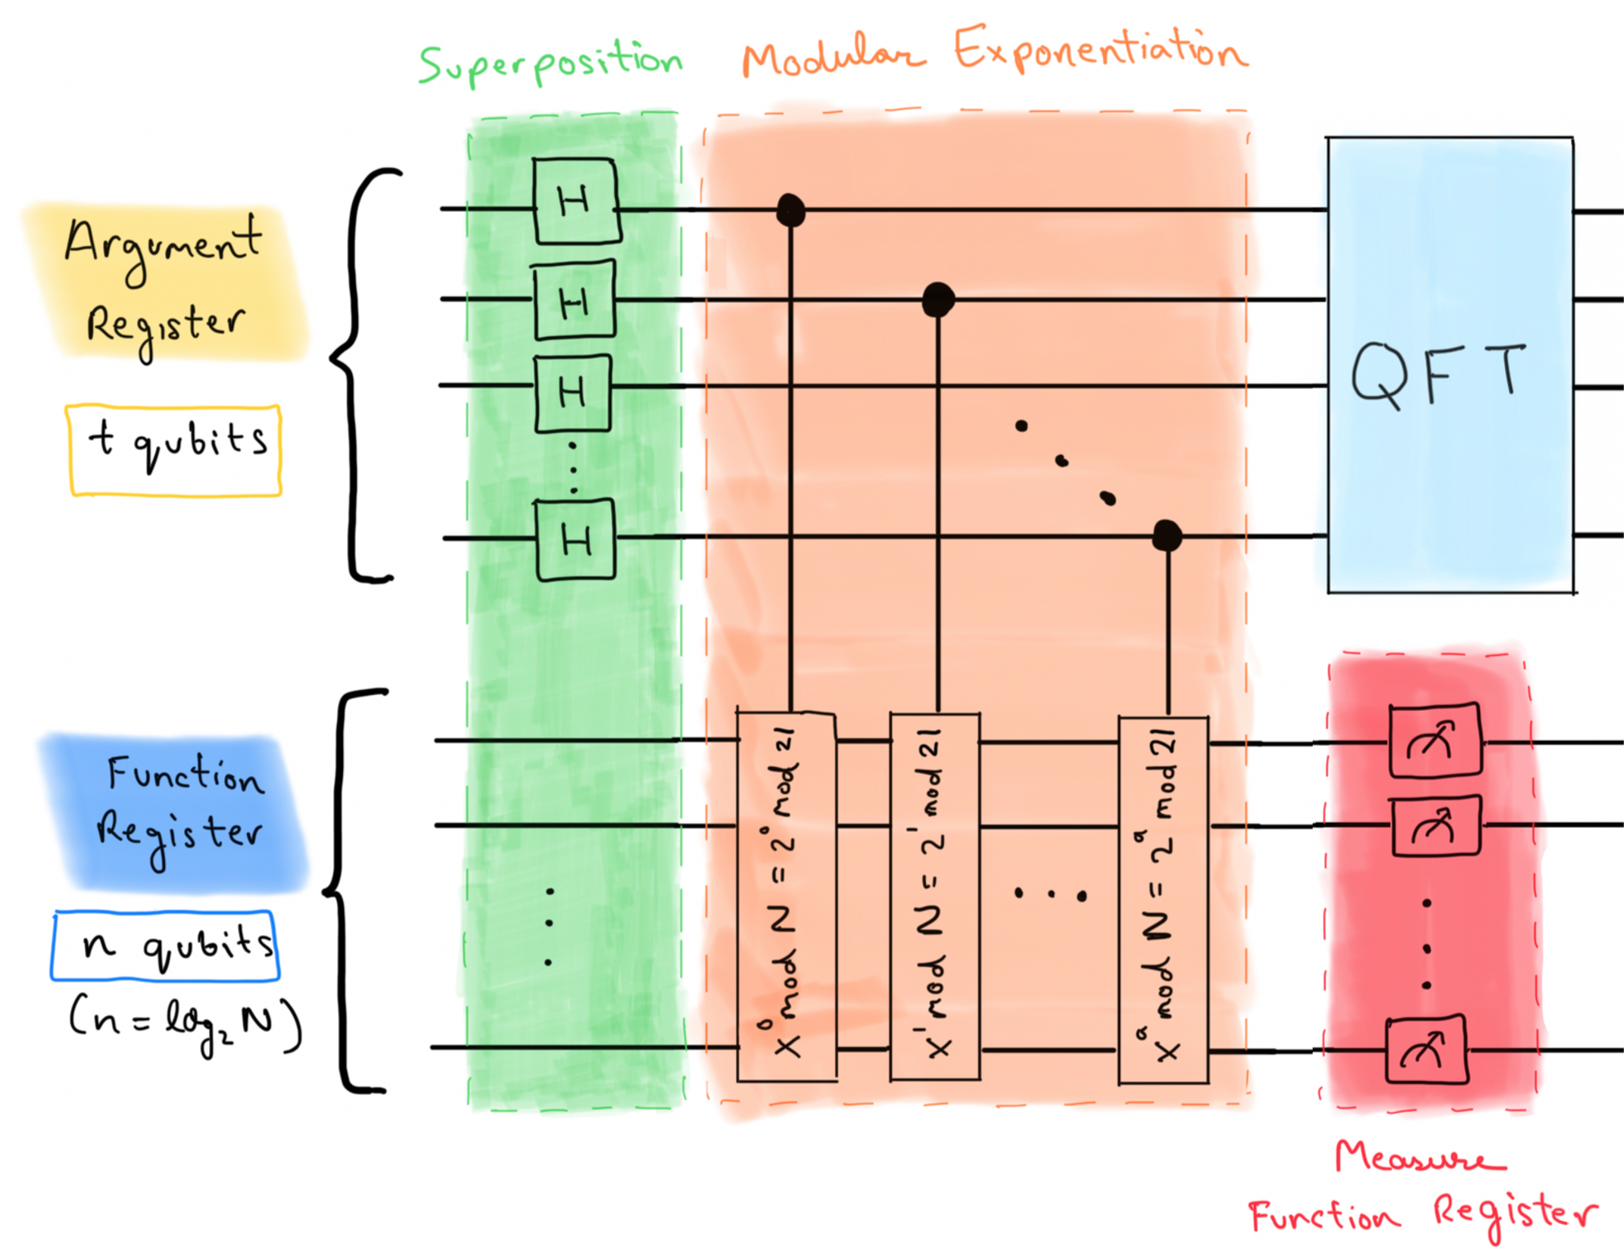
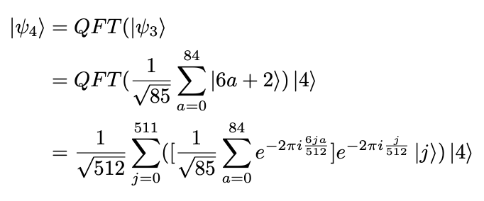
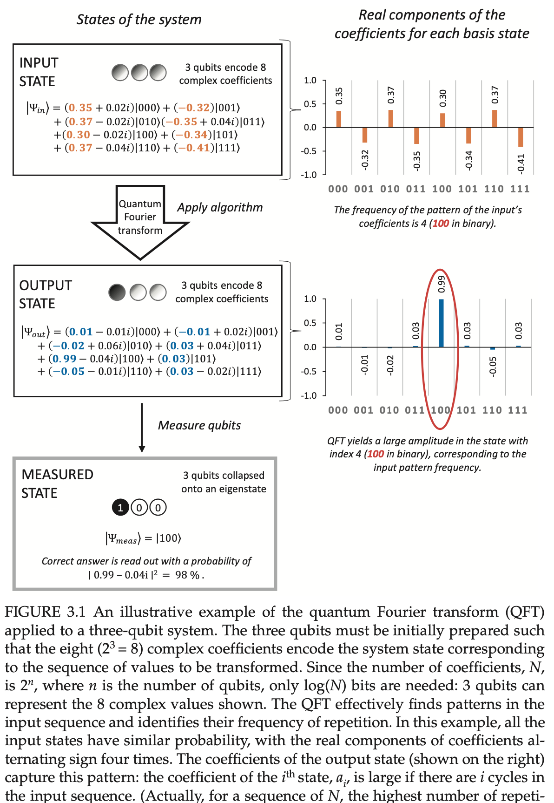
Quantum Fourier Transform (QFT)
(Measure Function Register)
(QFT on Function Register)
What does QFT do?
Notes:
One thing to note here is that it does not matter what the measurement result is because we are trying to extract the periodic pattern. This is captured by the values of the first (argument) register, and we can use QFT to obtain the period. Constructive interference.

Slide 12
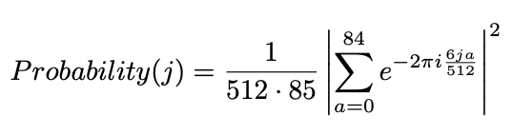
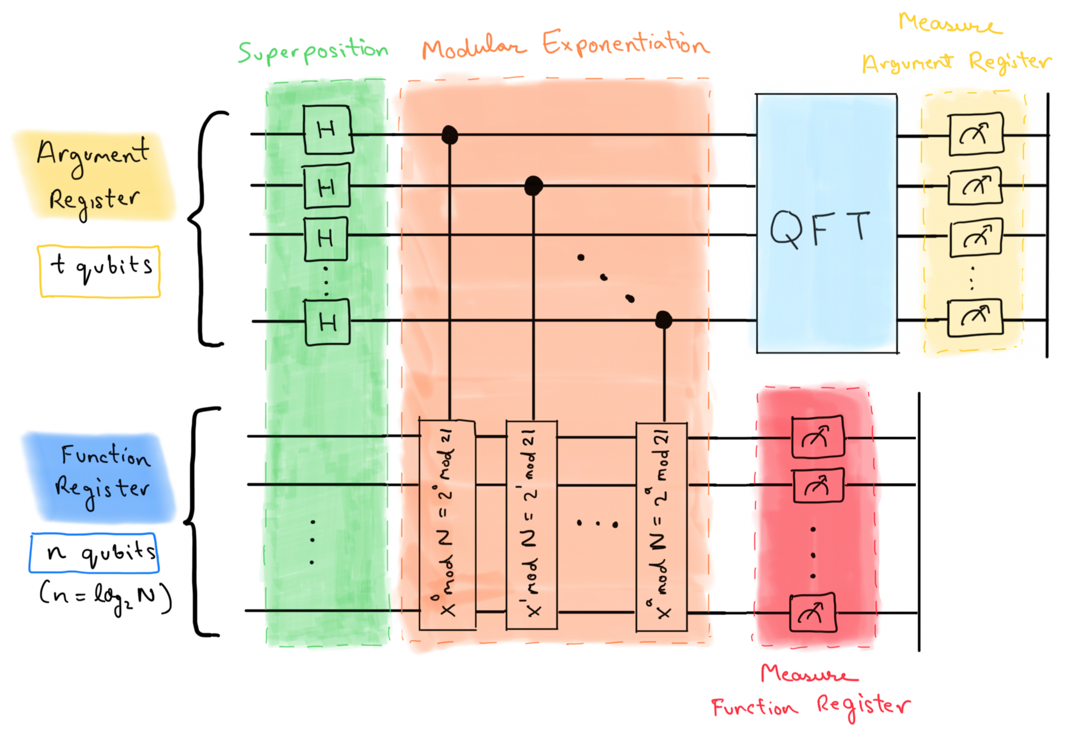
Derive the Period
(Measure Argument Register)
Let us say that the probabilities peak at
j = 0, 85, 171, 256, 341, 427.
Then, suppose the result is j = 85
for this measurement.
Period, r = T/j (or T modulo j)
r = 512 modulo 85
r = 6

Slide 13
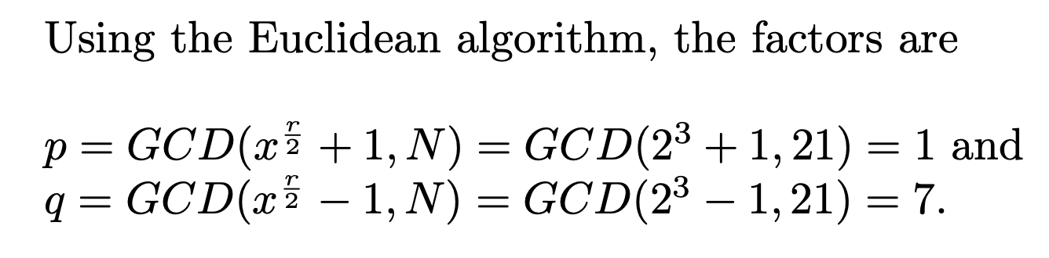
Factor Derivation

Slide 14
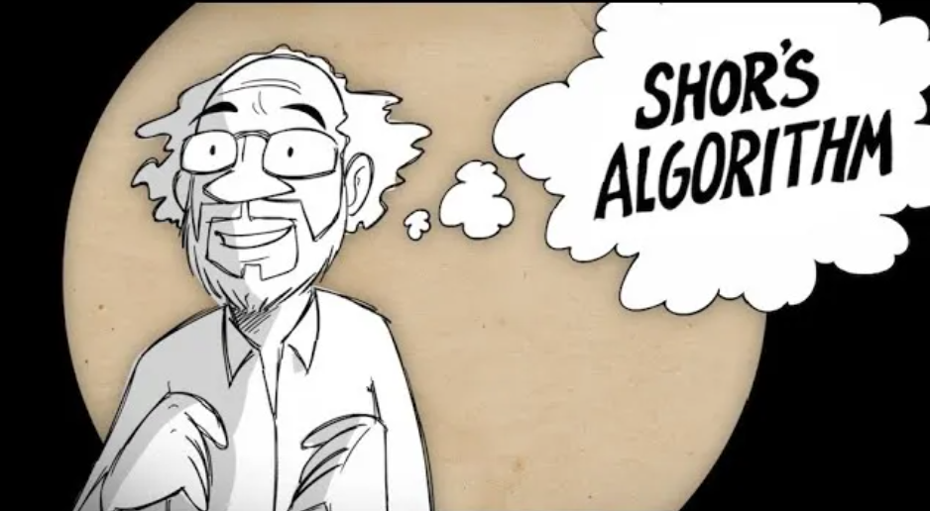
Any questions?

